Slide 1
States of matter
For parents
Thank you for supporting your child’s learning in science.
Before the session:
Please read slide 2 so you know what your child is learning and what you need to get ready.
As an alternative to paper, slide 7 may be printed for your child to record on.
During the session:
Share the learning intentions on slide 2.
Support your child with the main activities on slides 3-7, as needed.
Slide 8 has a further optional activity.
Slide 9 has a glossary of key terms.
Reviewing with your child:
Slide 10 gives an idea of what your child may produce.
Changes of state: comparing boiling
and evaporation
Year 4 Age 8 - 9

Slide 2
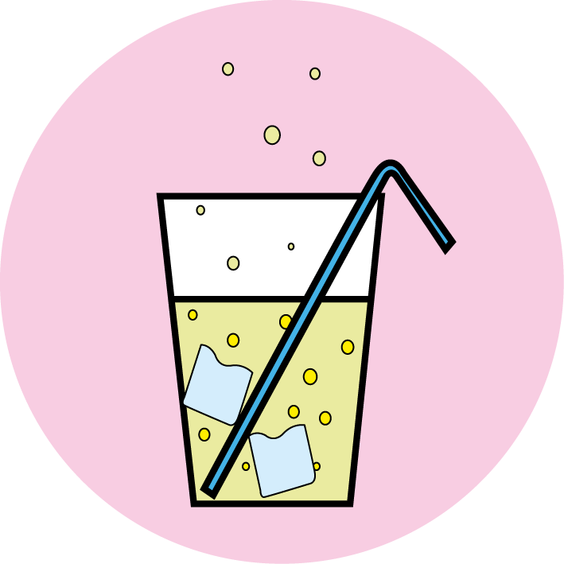
States of matter
Changes of state: comparing boiling and evaporation
Key Learning
Boiling and evaporation are both a change of state from liquid to gas.
Boiling happens at a specific temperature and bubbles of the gas can be seen inside the liquid. Water boils when it is heated to 100ºC.
Evaporation happens at any temperature and only at the surface of the liquid. It happens more quickly if the temperature is higher, the liquid has a larger surface area or it is windy.
Activities (pages 3-7): 40 - 45 mins, plus evaporating time!
Household items to support learning:
Three different sized bowls or containers.
A teaspoon and some water.
Use squared paper and a pencil. Alternatively may wish to print page 7 as a worksheet.
Find out more… (page 8)
You may like to make up your own investigation to explore how quickly water evaporates.
I can…
compare boiling and evaporation.
investigate how quickly water evaporates from different sized containers.

Slide 3
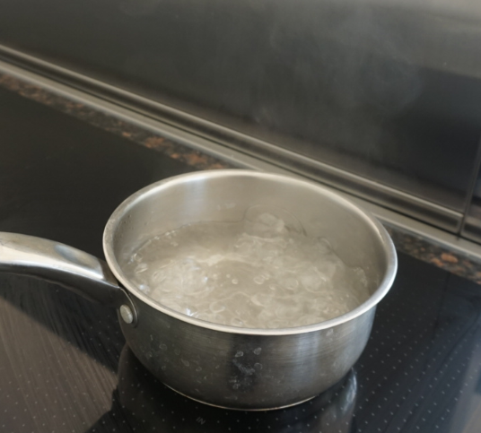
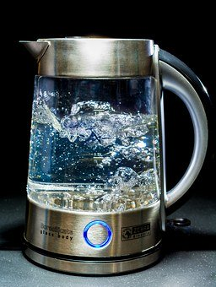
Explore, review, think, talk…
What do you already know about boiling and evaporation?
(5 minutes)
What is happening in these pictures?
When liquid water is heated it turns into a gas called water vapour.
Think or talk about what you see when you heat water in a pan.
What do you think is in the bubbles at the bottom of the water in this kettle?
Water vapour is invisible, but it often condenses in the cool air above a kettle or cup of tea, forming tiny droplets of steam.
In boiling water you can see bubbles of water vapour forming in the liquid.
What is the temperature of boiling water?
Watch this clip about boiling eggs: https://www.bbc.co.uk/bitesize/clips/z9d9wmn

Slide 4
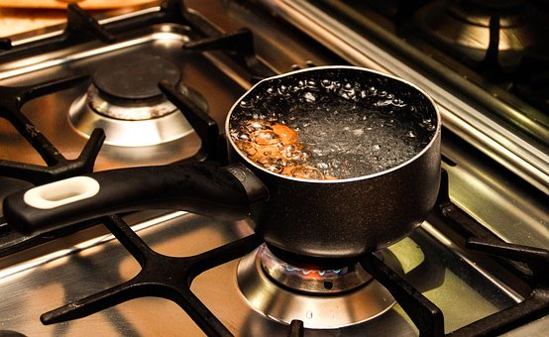
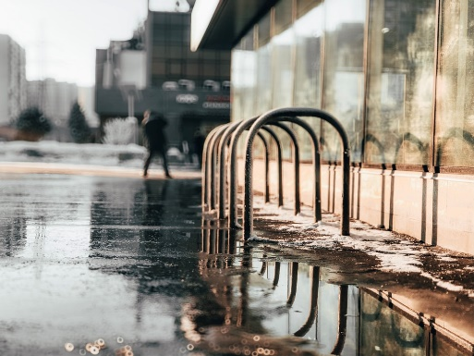
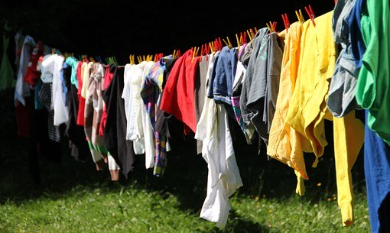
Comparing boiling and evaporating
Understanding the difference between boiling and evaporation
(10 minutes)
Boiling and evaporation are both changes of state when a liquid changes into a gas.
Boiling happens when a liquid is heated to a specific temperature and bubbles of the gas can be seen in the liquid.
Water boils at 100ºC.
Pure water cannot get hotter than 100ºC no matter how fast you boil it.
Evaporation can happen at any temperature. Gas evaporates from the surface of the liquid.
Water evaporates from the surface of puddles after it has rained.
Our washing dries when water evaporates from damp clothes.
What variables or factors might affect how quickly water evaporates from a puddle or from some clothes on a washing line?

Slide 5
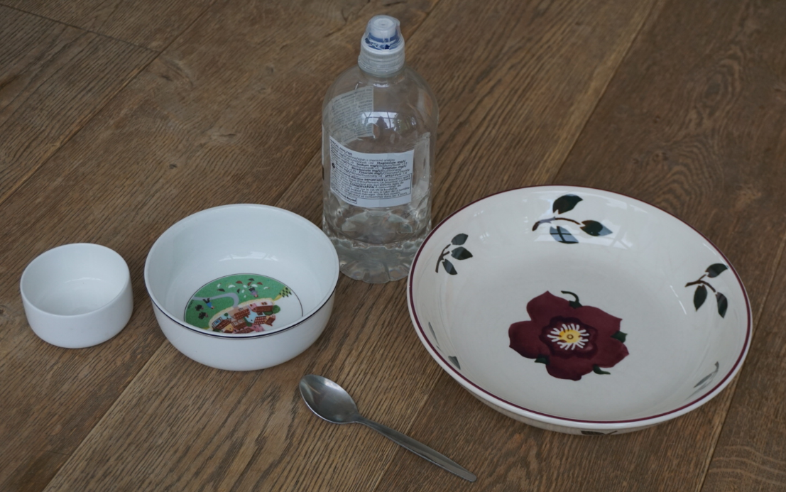
Investigating evaporation
Investigating how quickly water evaporates
(20-30 minutes, plus time for the water to evaporate)
Ask an adult if you can investigate how quickly water evaporates with them.
How long do you think it might take for water to evaporate?
Which variables might affect how long it takes?
How do you make sure your investigation is a comparative or fair test?
Try changing the size of the container so the water has a different surface area.
Think about the variables you will need to keep the same to make your test ‘fair’.
You will need:
Three different sized bowls or containers which have different surface areas.
A teaspoon and some water.
Amount of water?
Size of container?
Temperature of water?
Temperature of surroundings?
Amount of wind?

Slide 6
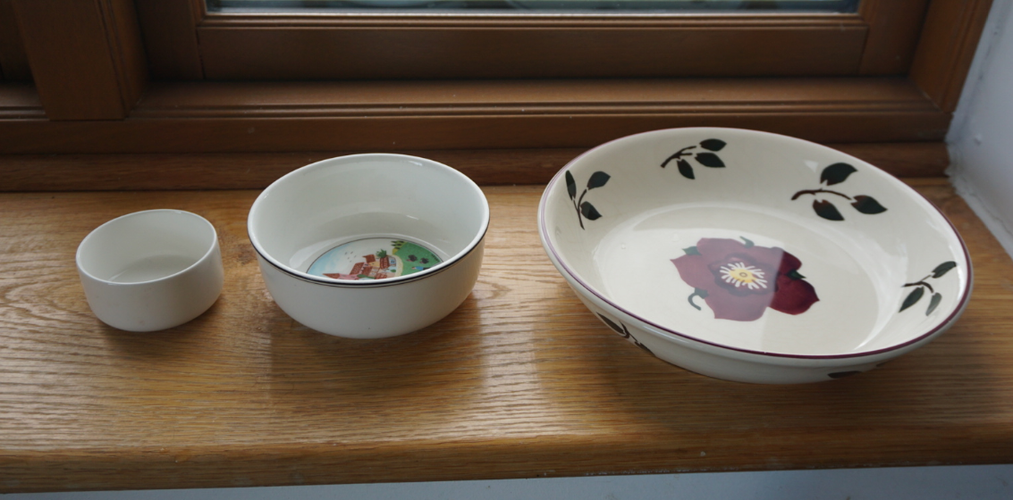
How quickly does water evaporate from different sized bowls or containers?
1. Find three different sized bowls or containers.
2. Collect some water and a teaspoon. Measure one teaspoon of water into each container.
3. Put the containers in the same place (it may be inside or outside, try to find a warm place). Write down the start time.
4. Check your containers every one or two hours. Is there any water left? Record your results.
5. Plot a bar graph to compare how quickly the water evaporates from each container.
From which container did the water evaporate the quickest? Can you explain why?
What might you do differently next time?
I can investigate how quickly water evaporates from different sized containers.
Time in hours | Is there any water left?
 | Container 1 (small) | Container 2 (medium) | Container 3 (large)

Slide 7
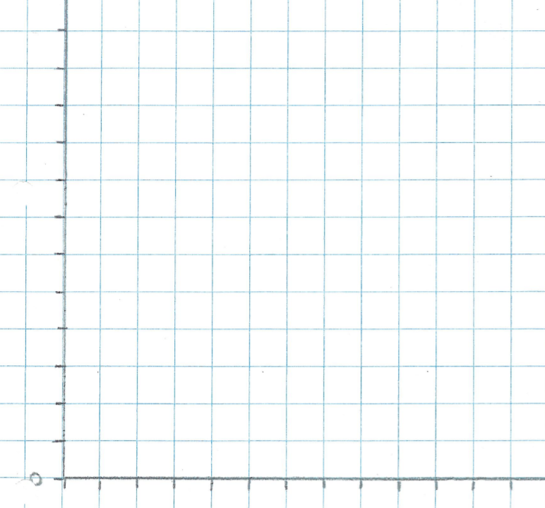
I can investigate how quickly water evaporates from different sized containers.
Time in hours | Is there any water left?
 | Container 1 (small) | Container 2 (medium) | Container 3 (large)
Time taken to evaporate (in hours)
Final results | Container 1 (small) | Container 2 (medium) | Container 3 (large)
Time taken for water to evaporate
0
0

Slide 8
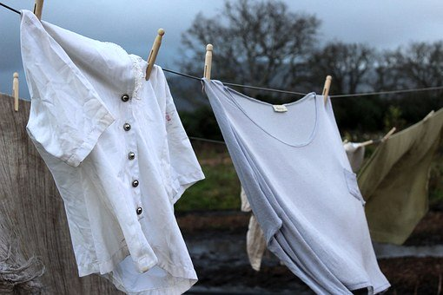
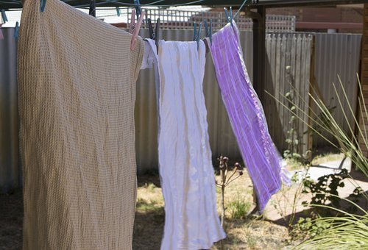
Taking it further…
Make up your own investigation to explore how quickly water evaporates
(20-30 minutes, plus time for the water to evaporate)
How else could you investigate evaporation?
You might like to hang up washing in different places and measure how long it takes to dry.
Think about how to make your test ‘fair’.
Decide how you are going to record your results and explain your findings.
You may like to take photographs.

Slide 9
Glossary of terms
States of matter: There are three states of matter: solid, liquid and gas.
Change of state: Liquids can change from a liquid to a gas. This is a change of state.
Temperature: Temperature measures how hot or cold a material is.
ºC (degrees Celsius): The temperature of a material is measured in ºC (degrees Celsius).
Boiling: Boiling is a change of state from liquid to gas which happens at a specific temperature. When a liquid is boiling, bubbles of the gas can be seen inside the liquid. Water boils when it is heated to 100ºC.
Evaporation: Evaporation is a change of state from liquid to gas which can happen at any temperature and only at the surface of the liquid.

Slide 10
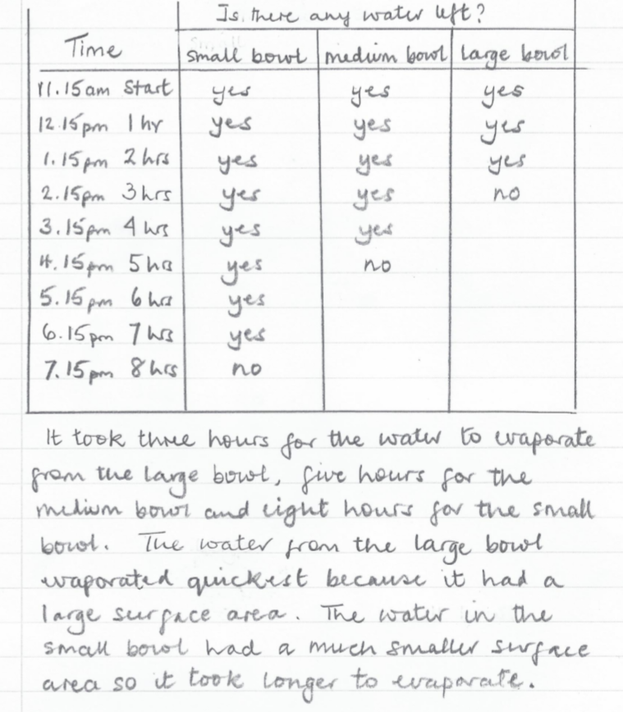
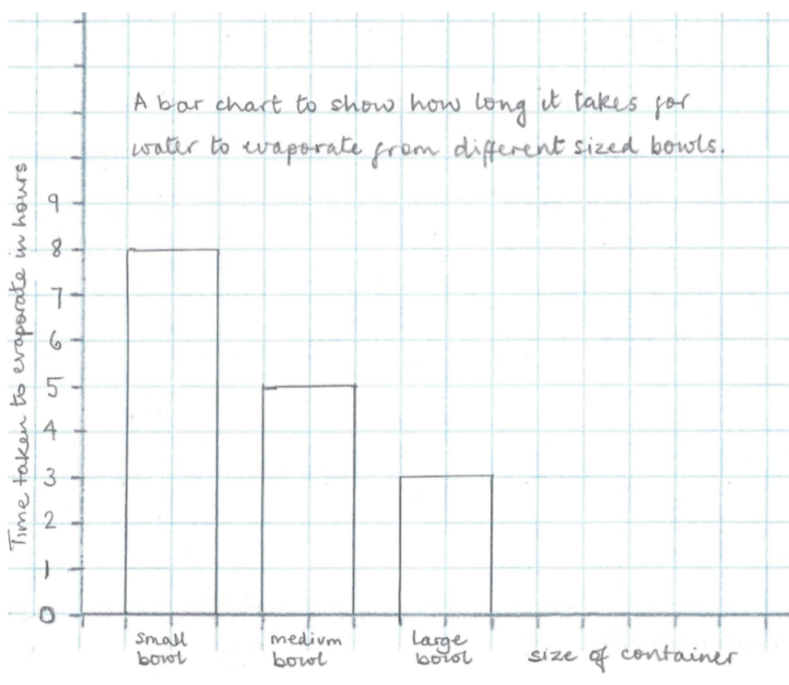
Water evaporates from the surface of a liquid so the larger the surface area exposed to the air, the faster the water will evaporate.
The surrounding temperature and amount of wind will also affect how quickly water evaporates. Do this outside on a warm, windy day to speed up your investigation!

